Slide 1

Wearables: non-functional approaches
JSM 2019

Slide 2
Overview
Review of PA, SL, CR
PA: Fragmentation
SL: Review, summary measures, mid-point
CR: parametric and non-parametric approaches
JIVE for PA, SL, CR
Adding contexts: EMA/Electronic diaries

Slide 3
Fragmentation

Slide 4
Fragmentation

Slide 5
References:
Di, J., Leroux, A., Urbanek, J., Varadhan, R., Spira, A., Schrack, J., Zipunnikov, V. Patterns of Sedentary and Active Time Accumulation Are Associated with Mortality in US adults: The NHANES Study https://www.biorxiv.org/content/biorxiv/early/2017/08/31/182337.full.pdf

Slide 6
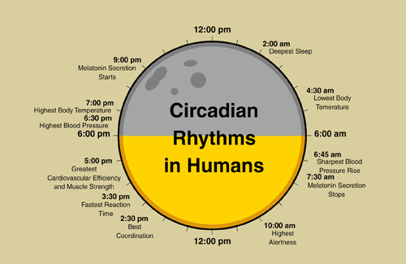
Circadian Clock

Slide 7
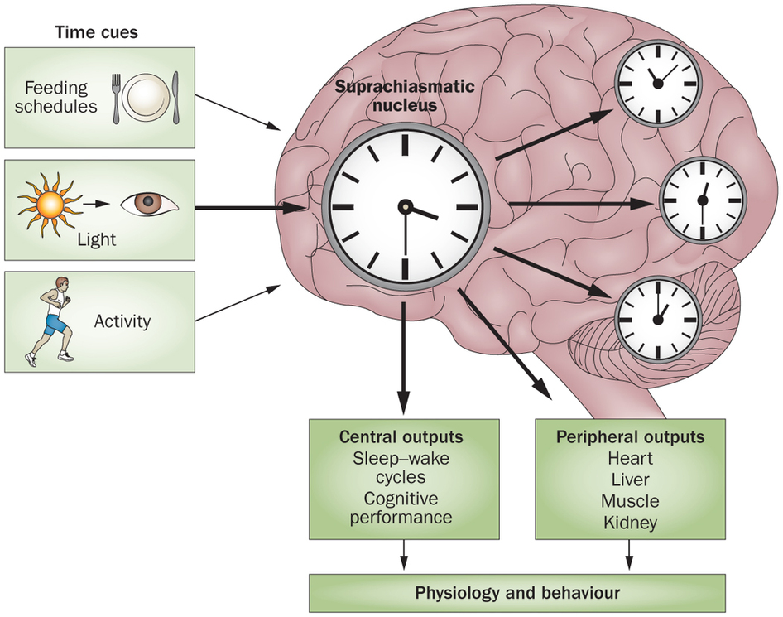
Circadian Clock
Suprachiasmatic nucleus (SCN) is a small region hypothalamus
SCN receives input from melanopsin-containing ganglion cells in retina
SCN modulates core body temperature and production of hormones (cortisol and melatonin)
SCN allows entrainment of daily rhythms to the 24-hour cycles in nature
Circadian dysregulation leads to circadian rhythm sleep disorders

Slide 8
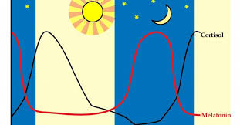
Circadian Rhythmicity and Disregulation
Circadian markers (hard to measure)
Melatonin
Cortisol
Core body temperature

Slide 9
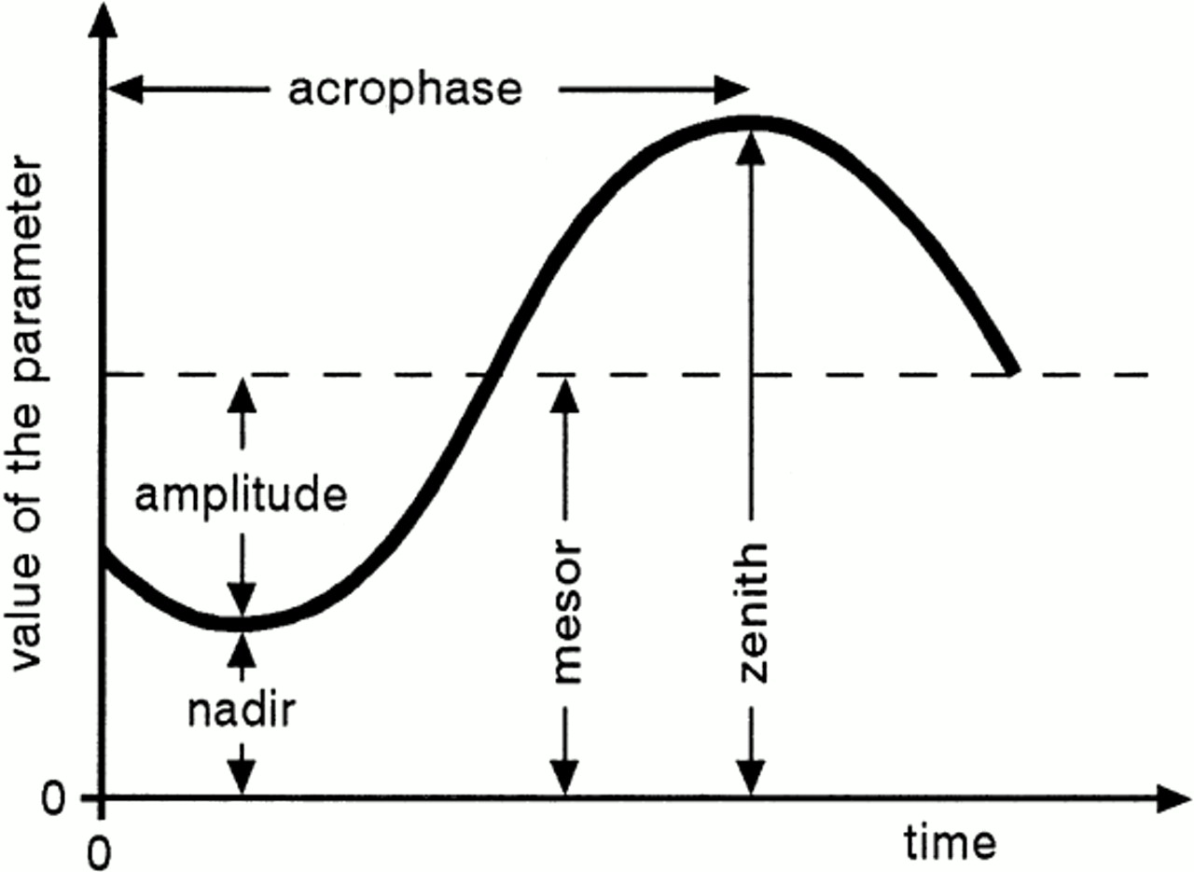
Circadian Rhythmicity (Actigraphy)
Cosinor-based models (period, amplitude, phase, phase-shifts)
Wavelet-based methods (time-frequency transformations)
Nonparametric methods: IV, IS, RA;

Slide 10
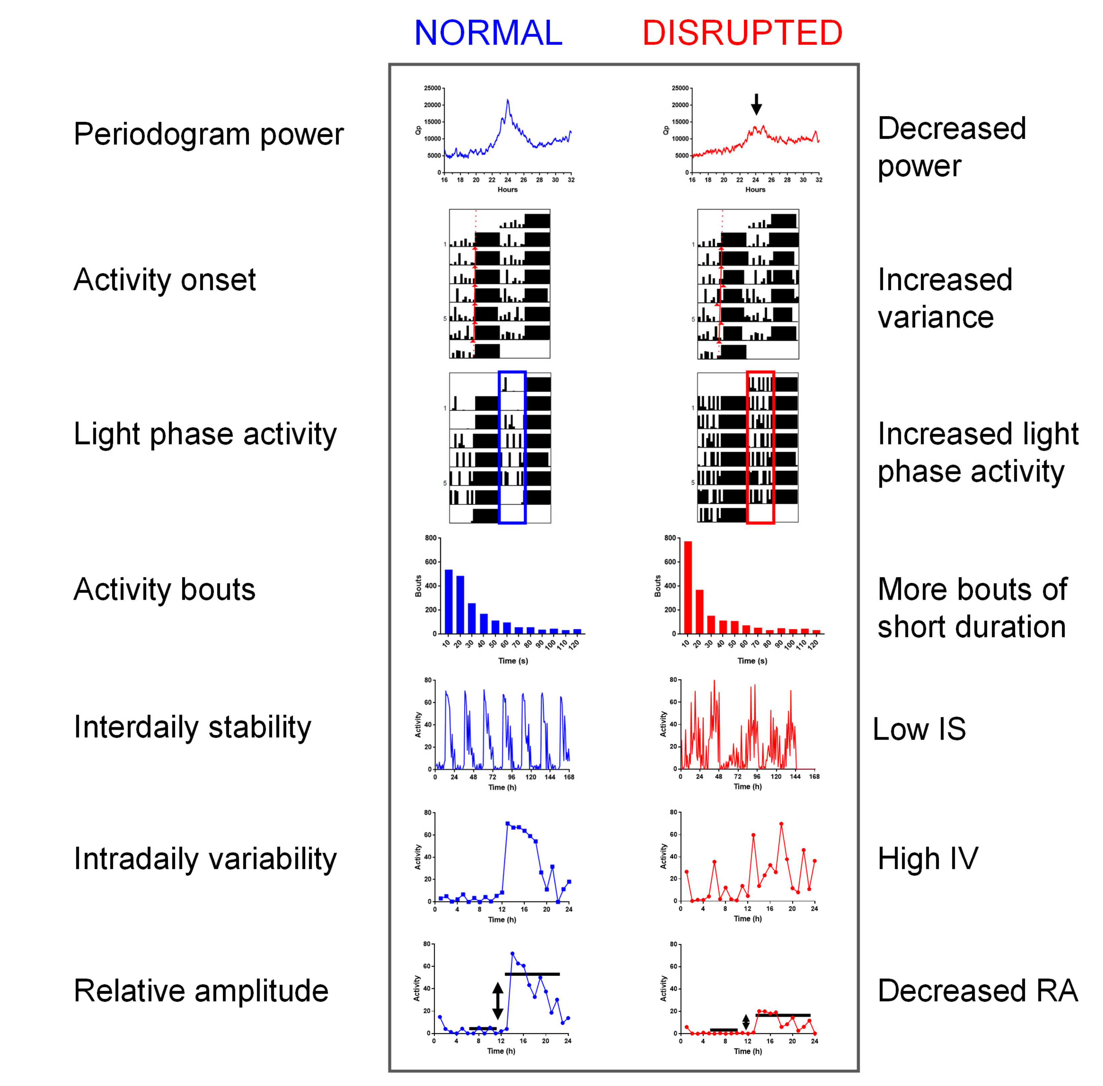
Telling the Time with a Broken Clock: Quantifying Circadian Disruption in Animal Models Laurence A. Brown † , Angus S. Fisk †, Carina A. Pothecary and Stuart N. Peirson; Biology (MDPI)

Slide 11
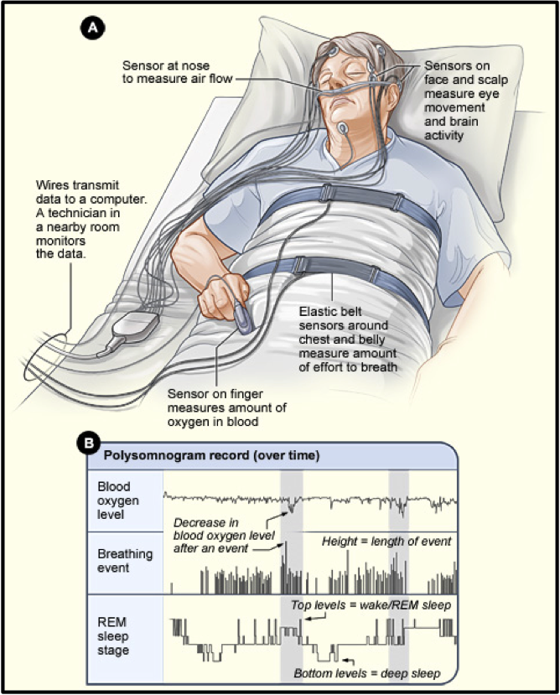
Sleep (PSG)
Polysomnography (golden standard)
Clinical Report:
Time in REM, NREM (1,2,3)
Desaturation summaries
Fragmentation
Limitations:
Invasive
Impractical for ambulatory applications

Slide 12
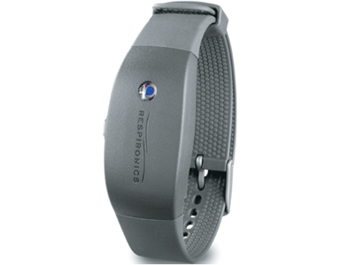
Sleep (Actigraphy)

Slide 13
Actigraphy-Measured Sleep Quality
Summaries
Total Sleep Time (TST)
Wake After Sleep Onset (WASO)
Number of Wake Bouts
Sleep Efficiency (SEFF)
Sleep Onset Latency
Major Limitations
cannot discriminate between sleep stages
No oxygenation information

Slide 14
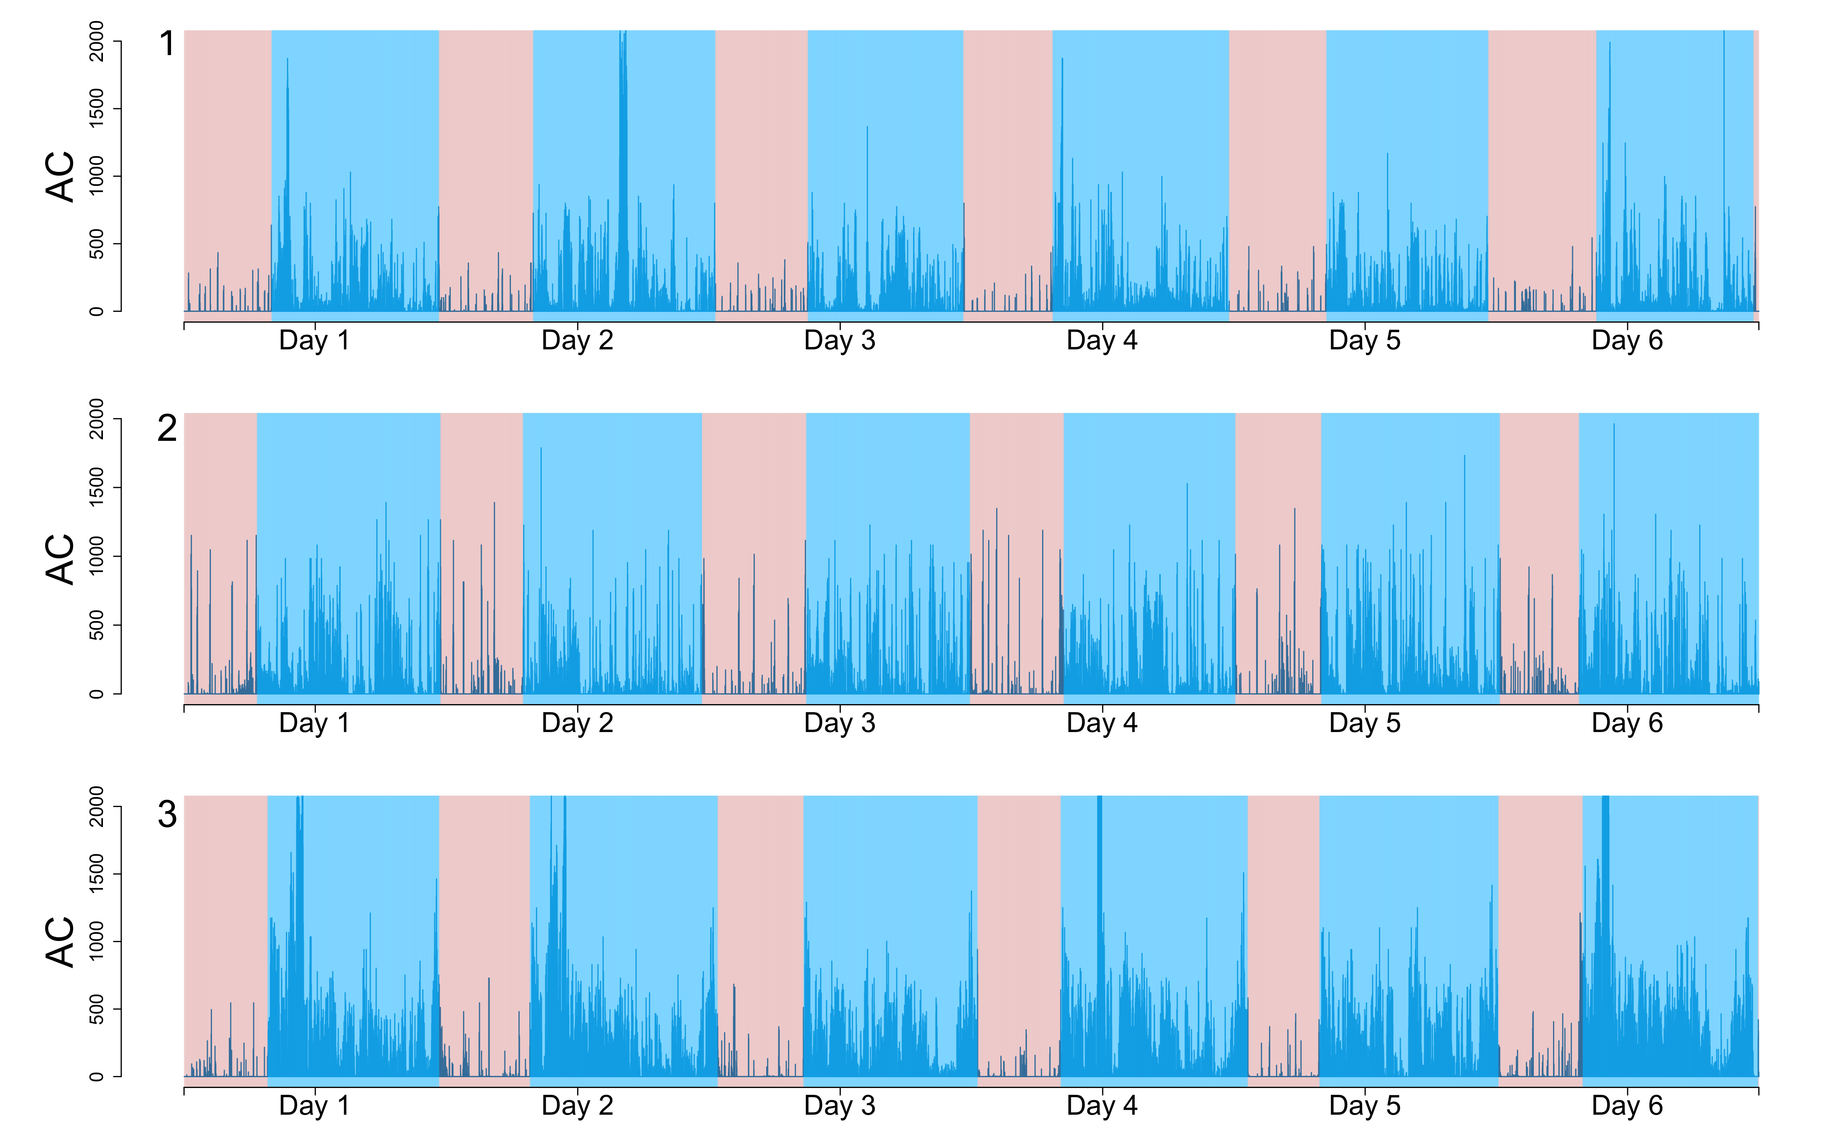
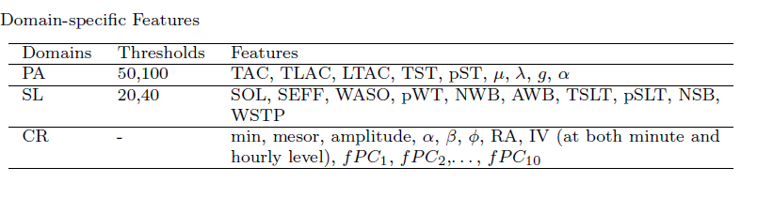
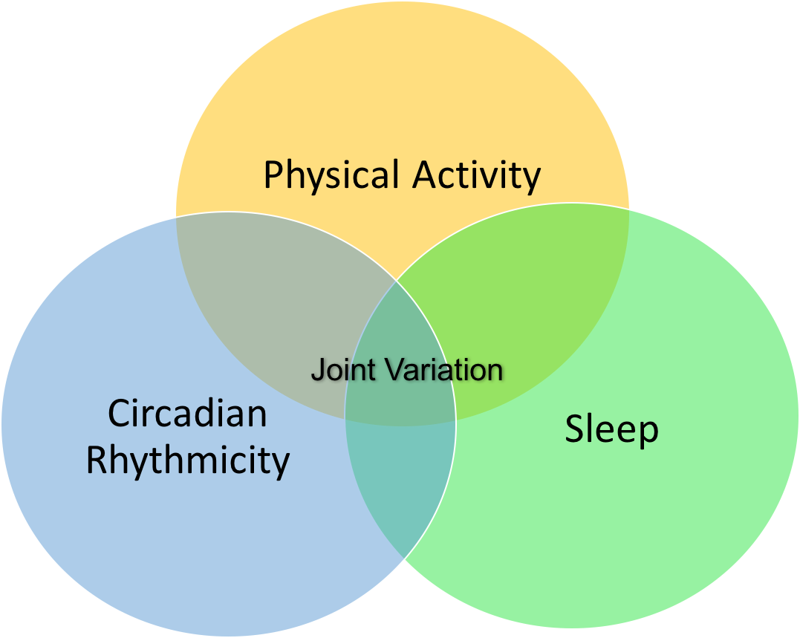
Joint and Individual Modelling of Sleep, Physical activity, Circadian Rhythmicity

Slide 15
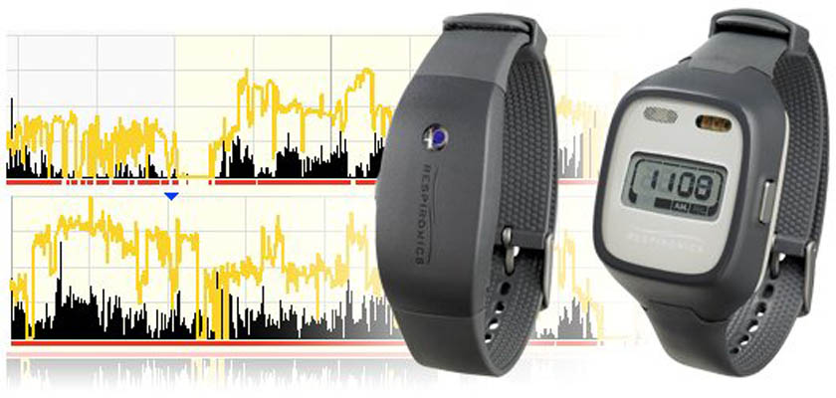
Baltimore Longitudinal Study of Aging
415 BLSA participants (aged 24 – 96 y.o.)
7 consecutive 24-hour periods measured with Actiwatch-2
Days with more than 5% daily missing data (72) were excluded. Subjects with fewer than 3 days of valid days were excluded
Features were averaged across days

Slide 16
Multi-Domain Data
Continuous actigraphy measurement enables us to study
Physical activity (PA): waking period
e.g. sedentary behavior and its accumulation patterns are risk factors for a wide range of diseases and mortality.
Sleep (SL): night time sleeping period
e.g. sleep has been shown to be associated with cognitive function and neurodegenerative disease.
Circadian rhythms: 24 hour oscillation
e.g. misalignment of circadian rhythm is associated with adverse metabolic and cardiovascular consequences.
Guided by specific questions, researches typically focus on one of the three domains without considering the joint dependence of features within and between the domains.
It becomes crucial to understand the joint effect of all three domains
Figure 9. 24-hour measurement for 6 days from BLSA

Slide 17
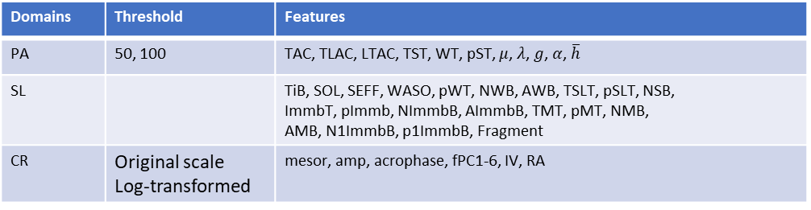
Multivariate within Each Domain
Domains | Threshold | Features
PA | 50, 100 | TAC, TLAC, LTAC, TST, WT, pST, $μ$, $λ$, $g$, $α$, $\overline{h}$
SL |  | TiB, SOL, SEFF, WASO, pWT, NWB, AWB, TSLT, pSLT, NSB, ImmbT, pImmb, NImmbB, AImmbB, TMT, pMT, NMB, AMB, N1ImmbB, p1ImmbB, Fragment
CR | Original scale Log-transformed | mesor, amp, acrophase, fPC1-6, IV, RA
The list of features can be easily expanded with new summaries or by applying different thresholds.
For multivariate data, dimension reduction can eliminate redundancy and capture most of relevant information.

Slide 18
Interdependency and Heterogeneity
Interdependency: same 24-hour cycles from the same group of subjects.
Heterogeneity: domains represent different physiological systems.

Slide 19
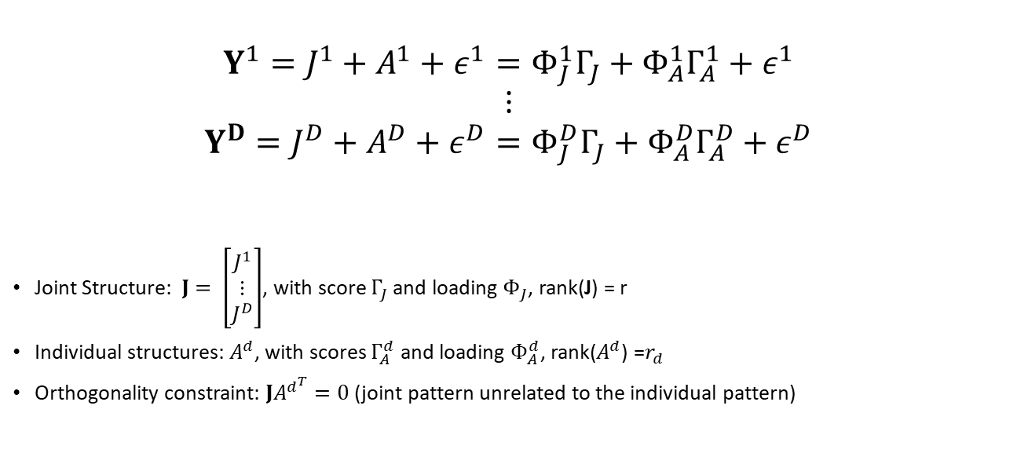
Joint and Individual Variation Explained (JIVE)
$$Y^{1}=J^{1}+A^{1}+ε^{1}=Φ_{J}^{1}Γ_{J}+Φ_{A}^{1}Γ_{A}^{1}+ε^{1}$$
$$⋮$$
$$Y^{D}=J^{D}+A^{D}+ε^{D}=Φ_{J}^{D}Γ_{J}+Φ_{A}^{D}Γ_{A}^{D}+ε^{D}$$
Joint Structure: $J= \left[\begin{aligned}J^{1} \\ ⋮ \\ J^{D}\end{aligned}\right]$, with score $Γ_{J}$ and loading $Φ_{J}$, rank(J) = r
Individual structures: $A^{d}$, with scores $Γ_{A}^{d}$ and loading $Φ_{A}^{d}$, rank($A^{d}$) =$r_{d}$
Orthogonality constraint: ${JA}^{d^{T}}=0$ (joint pattern unrelated to the individual pattern)

Slide 20
Scientific Applications: Model Gait Speed with Scores
Predictors | Beta | 95% CI | P Values | Predictors | Beta | 95% CI | P Values
JT-PC1 | 0.13 | (0.04, 0.22) | 0.0048 | SL-PC3 | -0.141 | (-0.32, 0.04 ) | 0.13
JT-PC2 | 0.084 | (-0.002, 0.17) | 0.056 | SL-PC4 | -0.178 | (-0.47, 0.11) | 0.23
JT-PC3 | -0.04 | (-0.13, 0.05) | 0.37 | CR-PC1 | -0.003 | (-0.09, 0.08) | 0.93
PA-PC1 | -0.035 | (-0.12, 0.05) | 0.41 | CR-PC2 | -0.07 | (-0.15, 0.02) | 0.11
PA-PC2 | 0.155 | (0.07, 0.24) | 0.0006 | CR-PC3 | 0.023 | (-0.06, 0.11) | 0.59
PA-PC3 | -0.07 | (-0.16, 0.016) | 0.11 | CR-PC4 | 0.03 | (-0.05, 0.11) | 0.48
SL-PC1 | -0.203 | (-0.33, -0.08) | 0.0012 | CR-PC5 | -0.01 | (-0.1, 0.08) | 0.82
SL-PC2 | 0.043 | (-0.04, 0.13) | 0.32
The model is adjusted by age, gender, and BMI (adj-R2 = 0.24)
PA-PC2 and SL-PC1 are highly loaded on activity and sleep fragmentation. (adj-R2 = 0.34)

Slide 21
References:
Di, J., Spira, A., Bai, J., Urbanek, J., Leroux, A., Wu, M., Resnick, S., Simonsick, E., Ferrucci, L., Schrack, J. and Zipunnikov, V., 2019. Joint and Individual Representation of Domains of Physical Activity, Sleep, and Circadian Rhythmicity. Statistics in Biosciences, pp.1-32.

Slide 22
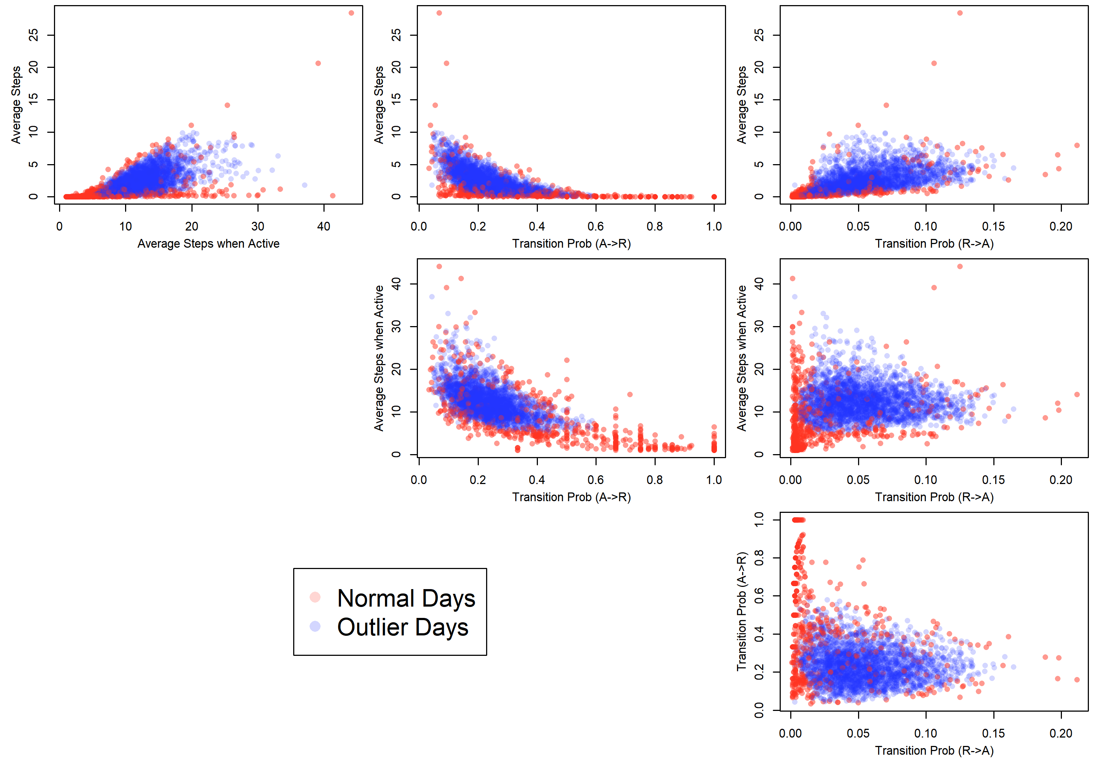
Automatically Detecting Outlying Days
Methods for Step Count Data: Determining “Valid” Days using Support Vector Machine and Quantifying Fragmentation of Walking Bouts (submitted to Gait and Posture)
Lisa Reider, Jiawei Bai, Daniel Scharfstein, Vadim Zipunnikov

Slide 23
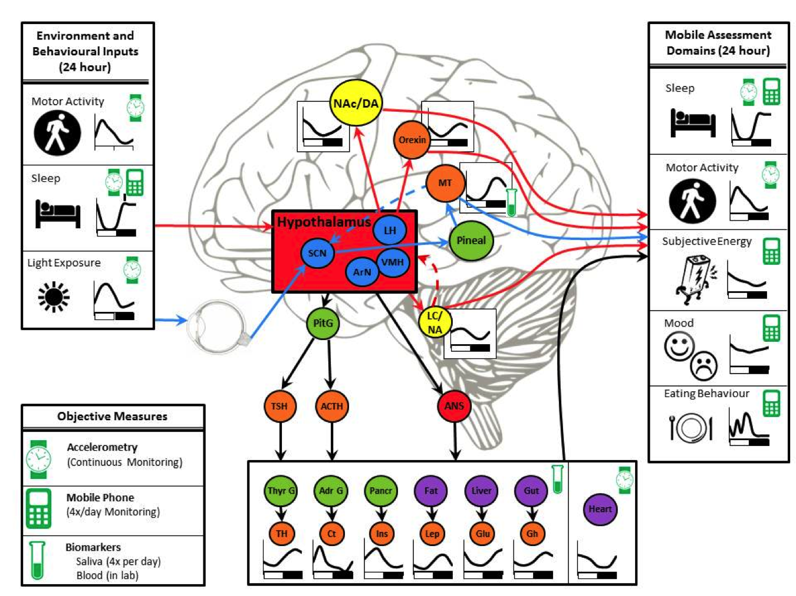
EMA data
Notes:
OUR findings that demonstrate the feasibility of tracking multi-system inter-relationships with mobile technologies affords new opportunities for translational mechanistic studies.
Tracking of these systems and their inter-relationships could foster progress in our understanding of its underlying neural circuits^{105,106} - as depicted in this figure.
The diurnal shift in activation and energy in BPI might reflect regulatory hypocretinergic systems and their catecholaminergic modulation^{107,108} that could be tested in parallel preclinical studies.
Greater cross-system inter-relationships in persons with BPI than among controls further also suggests that BPD may reflect a broader disturbance in regulatory systems that coordinate homeostatic processes.

Slide 24
EMA Data
Challenges:
Normalization of subject-specific interpretation of the scales (1-7, 1-10)
Continuous modelling of ordinal scales
Mixed data types: exponential family
Daily observations: weekly patterns
Bringing context: work/work-free days, etc
Subject-specific vs population-level modeling/prediction

Slide 25
Important considerations
Normalize to the subject-specific internal clock
Estimate subject-specific diurnal pattern
Understand subject-specific weekly pattern
Do subject-specific normalization of the measurement (AC, subjective scores)
The subject-specific norm is defined by 1-4.
Dynamic deviations from the subject-specific norm (defined by 1-4) can be used for dynamic prediction

Slide 26
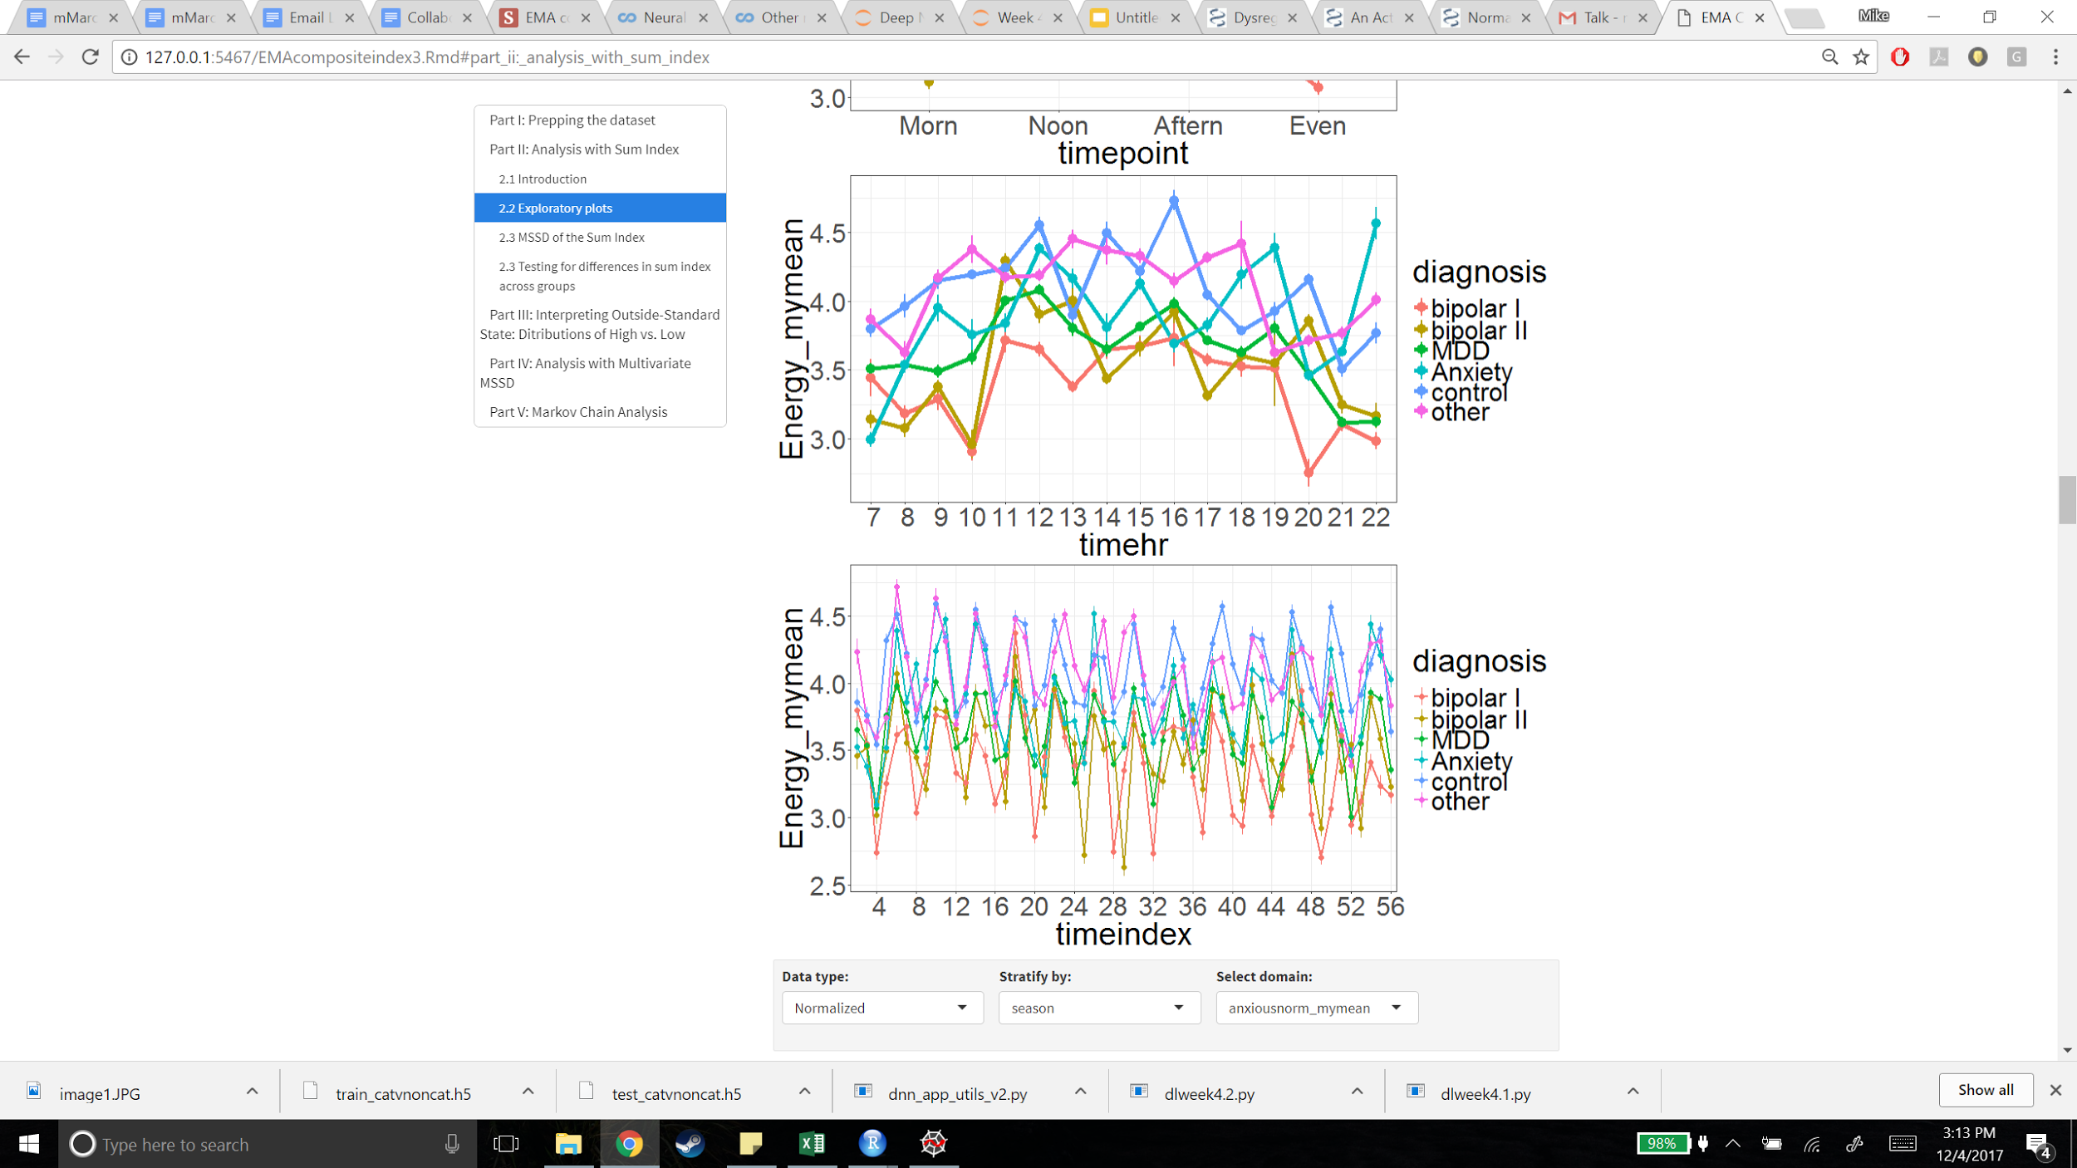
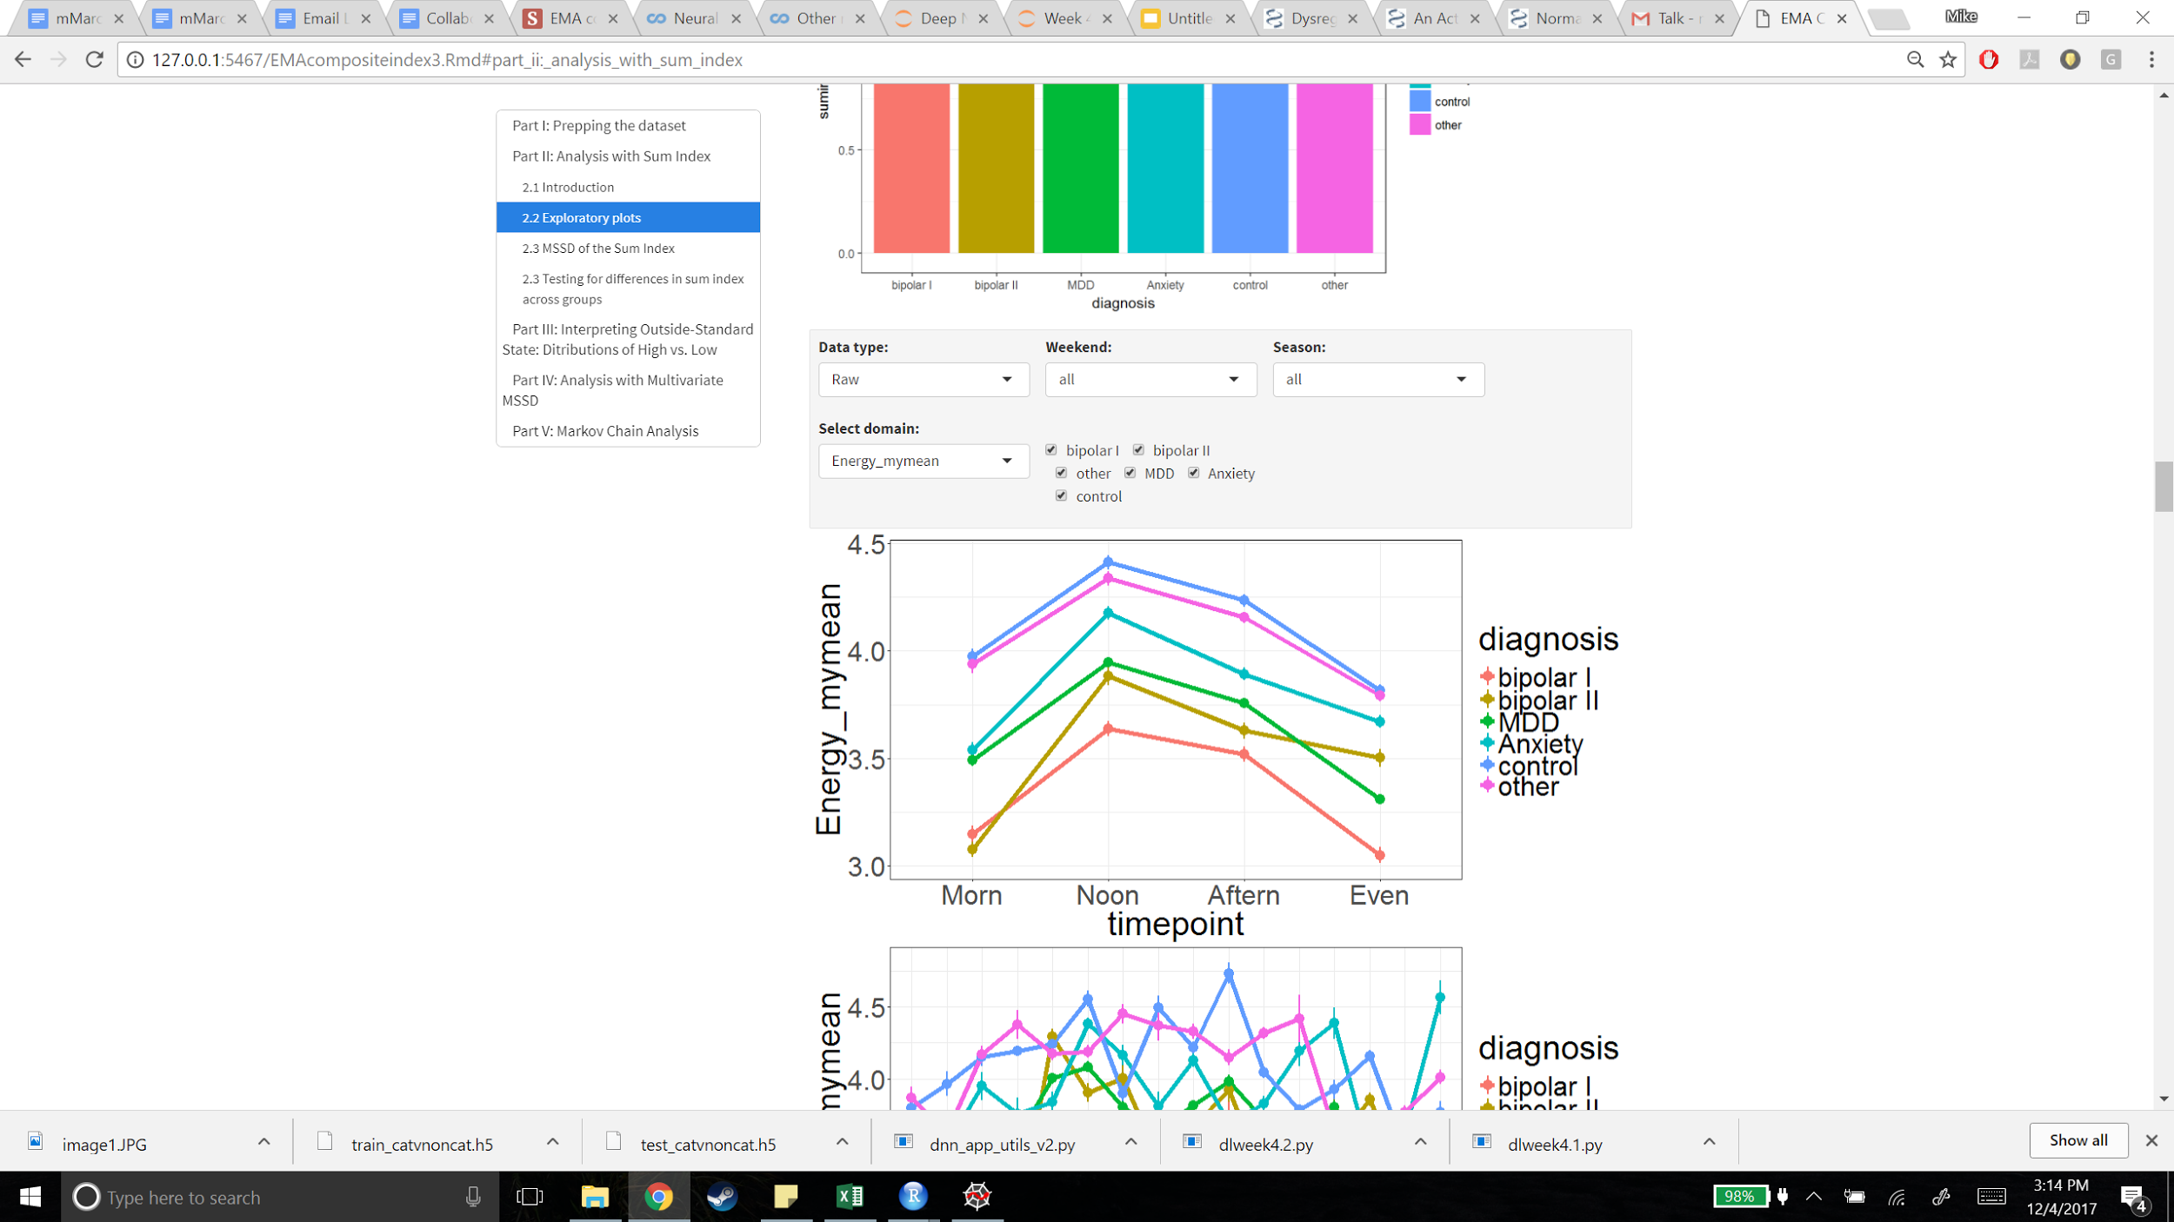
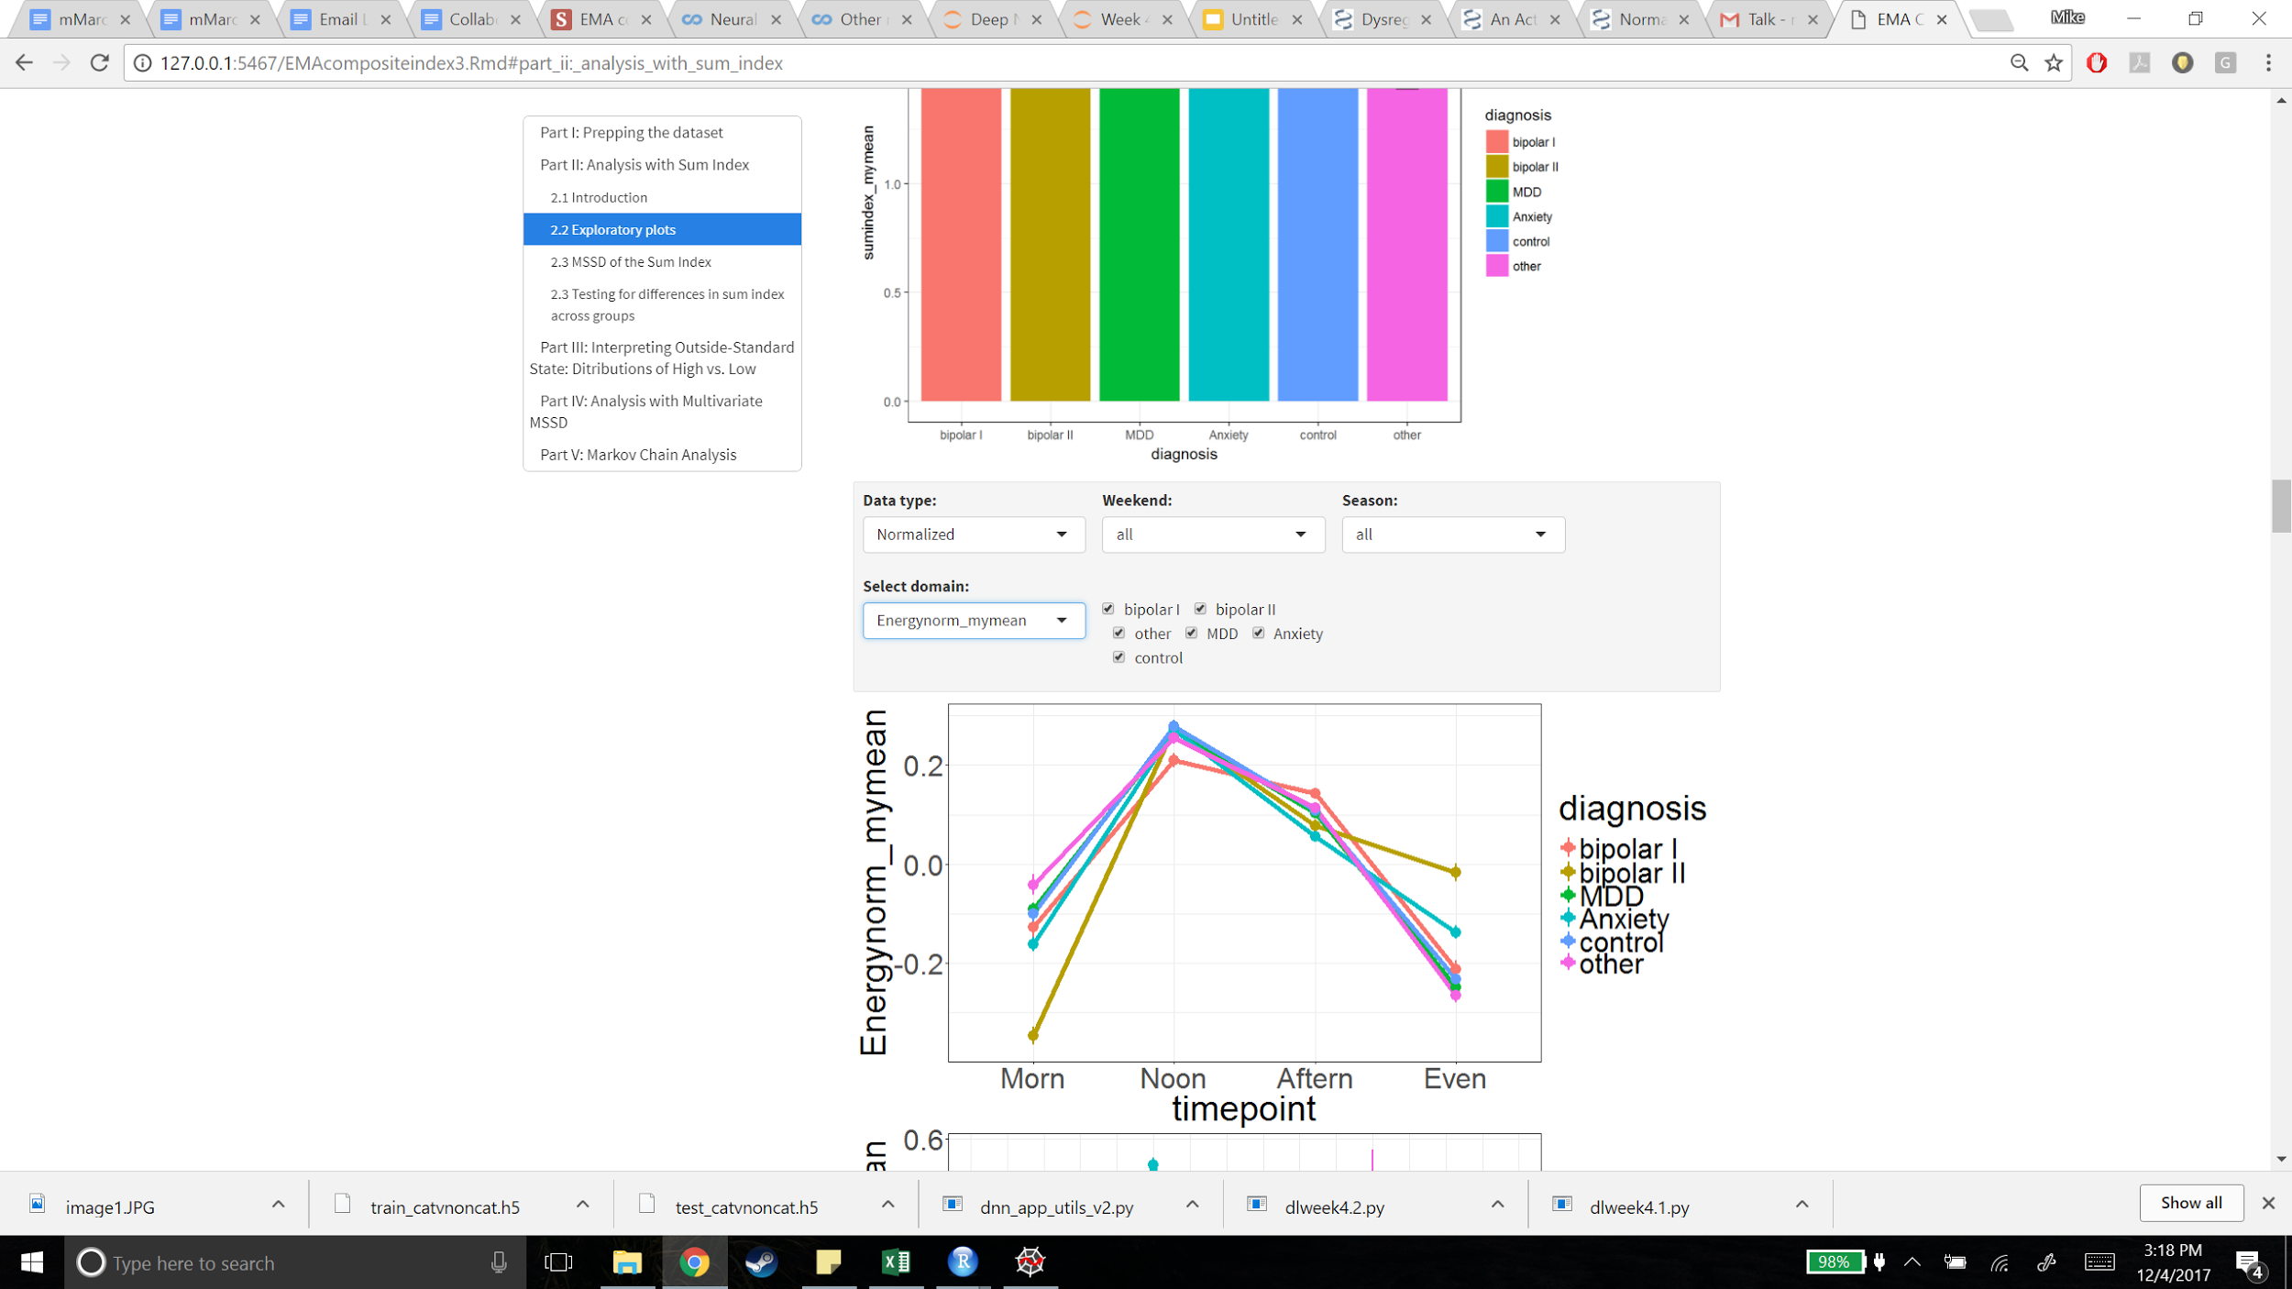
Steps 1 and 2: internal (wake) time and diurnal patterns

Slide 27
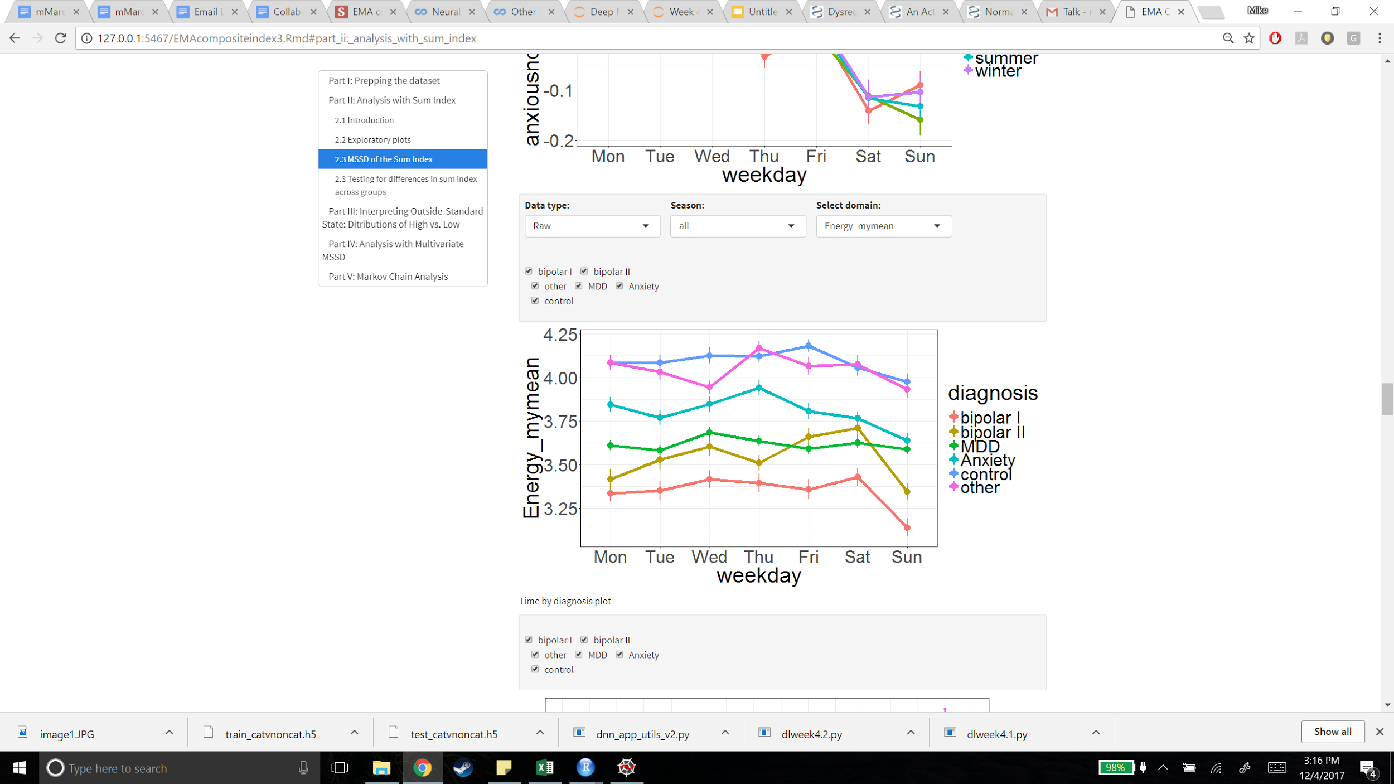
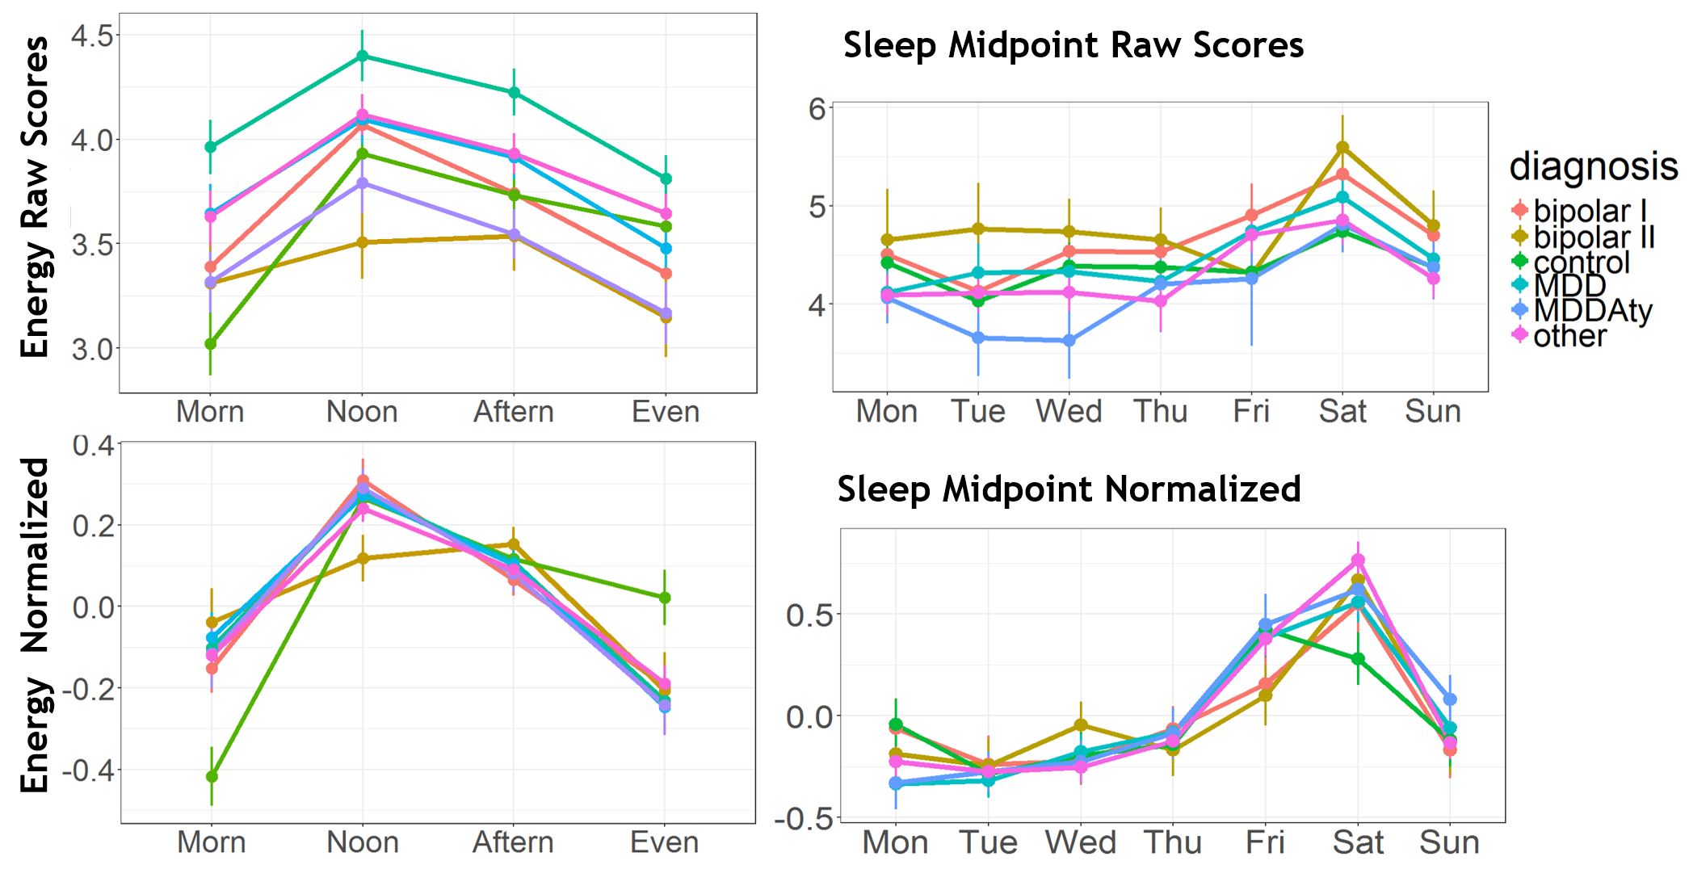
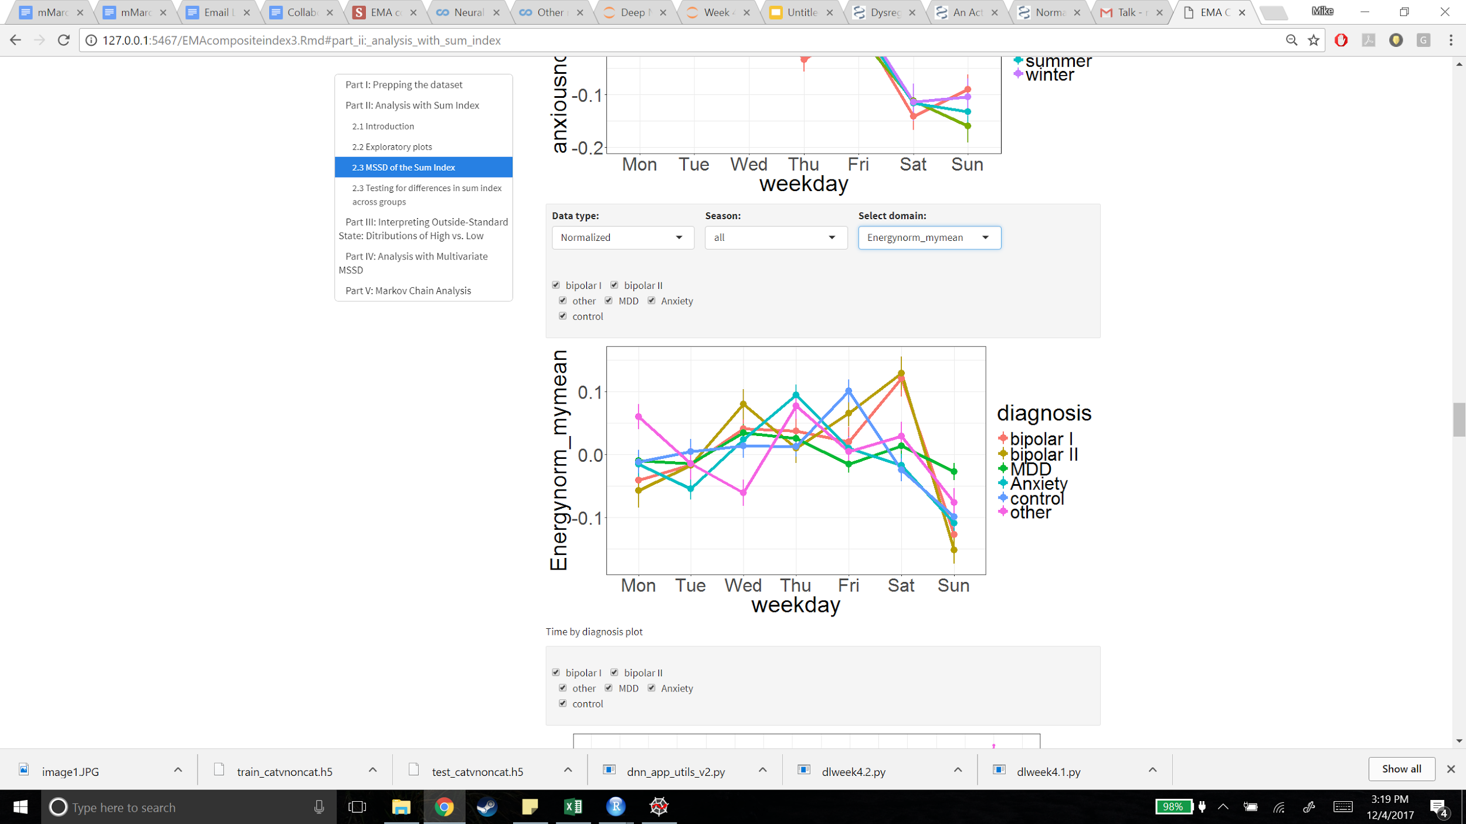
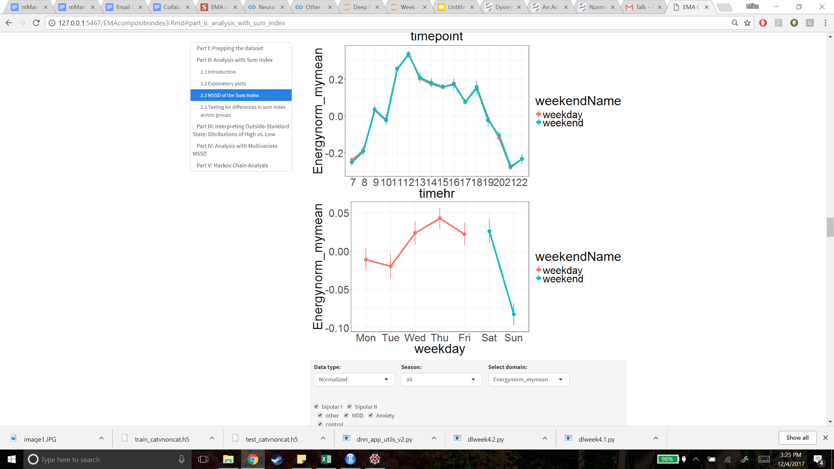
Step 3: Subject-specific weekly patterns

